Slide 1

8th Grade Math: Pre-Algebra
Unit 7, Lesson 9 Writing Equations for Real-World Contexts Volume 1, pg. 326

Slide 2


Benchmark
MA.8.AR.3.3
Given a table, graph or written description of a linear relationship, write an equation in slope-intercept form.
volume 1, pg. 326

Slide 3
Integrated Mathematical Thinking and Reasoning Standards
MA.K12.MTR.7.1 Apply mathematics to real-world contexts.
volume 1, pg. 326

Slide 4

Learning Target
I can write the equation of a linear relationship in slope‑intercept form given a graph, table of values, or written description for a real-world context.
volume 1, pg. 326

Slide 5

Warm-Up
volume 1, pg. 327

Slide 6
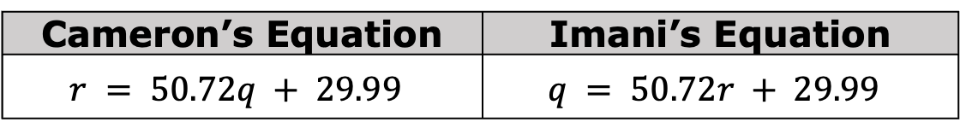
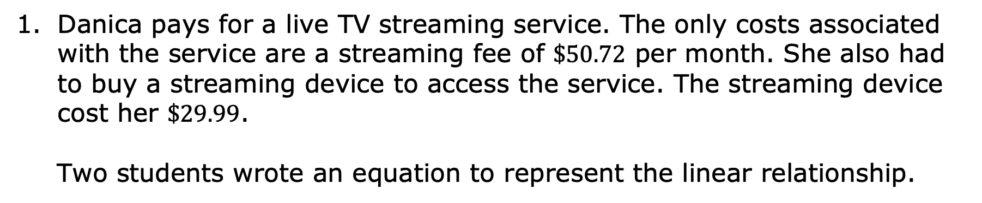
7.9.1 Warm-Up: Whom Do You Agree With?
Danica pays for a live TV streaming service. The only costs associated with the service are a streaming fee of $\$50.72$ per month. She also had to buy a streaming device to access the service. The streaming device cost her $\$29.99$.
Two students wrote an equation to represent the linear relationship.
Cameron’s Equation | Imani’s Equation
$$r = 50.72q + 29.99$$ | $$q = 50.72r + 29.99$$
volume 1, pg. 327

Slide 7

wrote the correct equation because ___________________________________________________________________________________________________________.
volume 1, pg. 327

Slide 8

Guided Instruction
volume 1, pg. 327

Slide 9

7.9.2 Guided Instruction: Writing Equations for Real-World Contexts
Consider the equations Cameron and Imani wrote to represent the situation in the Warm-Up.
What did both students do correctly when writing their equations?
volume 1, pg. 327

Slide 10

Neither student defined the variables for the situation, which makes it difficult to determine which equation accurately represents the context.
Defining Variables
When writing equations to represent real-world contexts, any variables used must be defined to identify which quantity each variable in the equation represents.
If 𝑟 is the number of months Danica continues the streaming service and 𝑞 is the total cost to Danica, which student wrote the correct equation?
volume 1, pg. 327

Slide 11
In this context, which quantity is the independent variable?
Which quantity is the dependent variable?
volume 1, pg. 327

Slide 12
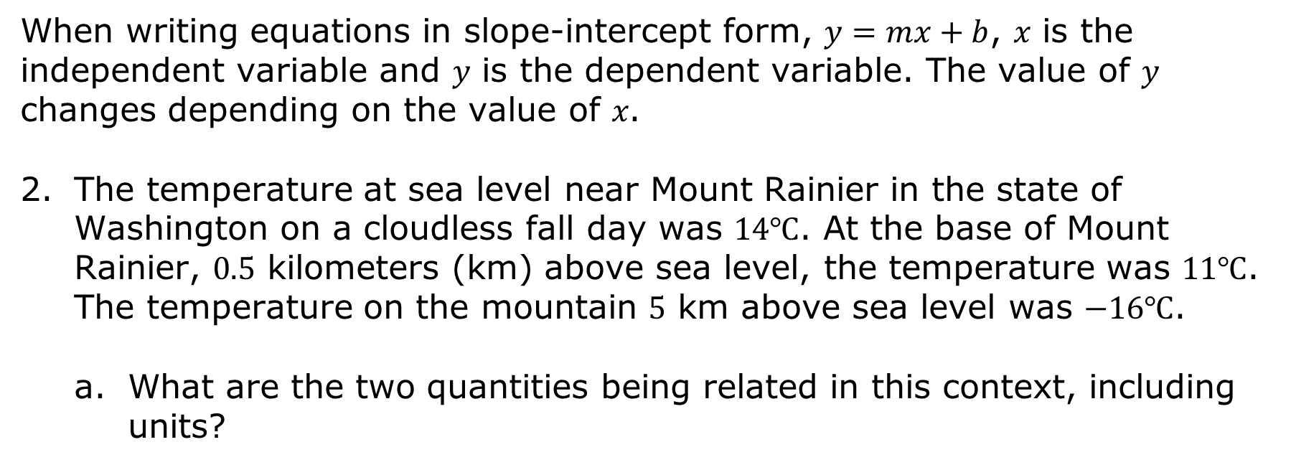
When writing equations in slope-intercept form, $y=mx+b$, 𝑥 is the independent variable and 𝑦 is the dependent variable. The value of 𝑦 changes depending on the value of 𝑥.
The temperature at sea level near Mount Rainier in the state of Washington on a cloudless fall day was $14℃$. At the base of Mount Rainier, $0.5$ kilometers (km) above sea level, the temperature was $11℃$. The temperature on the mountain $5$ km above sea level was $−16℃$.
What are the two quantities being related in this context, including units?
volume 1, pg. 328

Slide 13
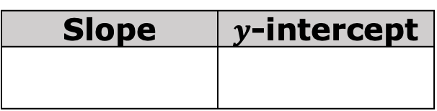
Define each quantity with a variable.
Place an asterisk (*) next to the independent variable.
There is a linear relationship between the temperature and altitude. Find the slope and 𝑦-intercept for this relationship.
Slope | $y$-intercept
Write the equation of the linear relationship using the defined variables.
volume 1, pg. 328

Slide 14

Guided Practice
volume 1, pg. 328

Slide 15

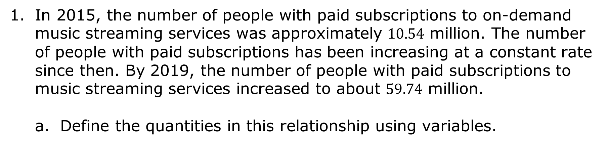
7.9.3 Guided Practice: Writing Equations for Real-World Contexts
In 2015, the number of people with paid subscriptions to on-demand music streaming services was approximately $10.54$ million. The number of people with paid subscriptions has been increasing at a constant rate since then. By 2019, the number of people with paid subscriptions to music streaming services increased to about $59.74$ million.
Define the quantities in this relationship using variables.
volume 1, pg. 328

Slide 16
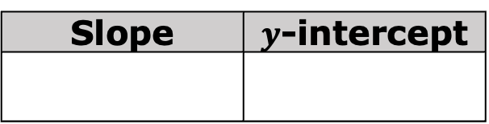
Find the slope and 𝑦-intercept for this relationship.
Slope | $y$-intercept
Write an equation to represent the relationship between the number of people, in millions, with paid subscriptions to music streaming services, and the number of years since 2015.
volume 1, pg. 328

Slide 17
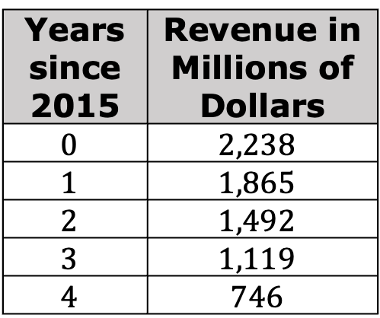
Due to the increase in music streaming platforms, the revenue earned by the music industry from downloaded music content has decreased over the same period of time. The table shows the approximate revenues earned each year from 2015 to 2019, in millions of dollars.
Years since 2015 | Revenue in Millions of Dollars
$$0$$ | $$2,238$$
$$1$$ | $$1,865$$
$$2$$ | $$1,492$$
$$3$$ | $$1,119$$
$$4$$ | $$746$$
Work with your partner to write an equation that represents the relationship between the quantities in this context.
volume 1, pg. 329

Slide 18

Your Turn
volume 1, pg. 329

Slide 19

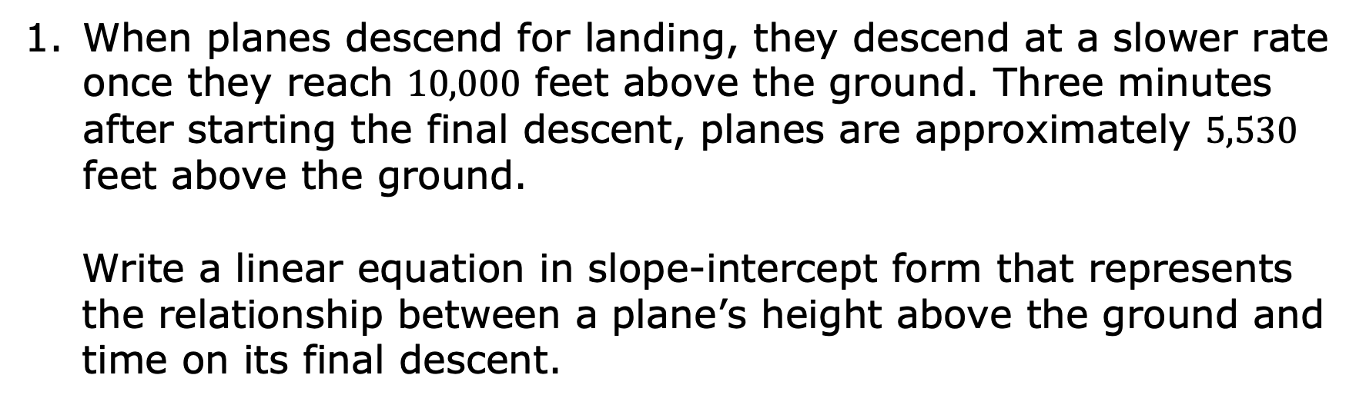
7.9.4 Your Turn!
When planes descend for landing, they descend at a slower rate once they reach $10,000$ feet above the ground. Three minutes after starting the final descent, planes are approximately $5,530$ feet above the ground.
Write a linear equation in slope-intercept form that represents the relationship between a plane’s height above the ground and time on its final descent.
volume 1, pg. 329

Slide 20
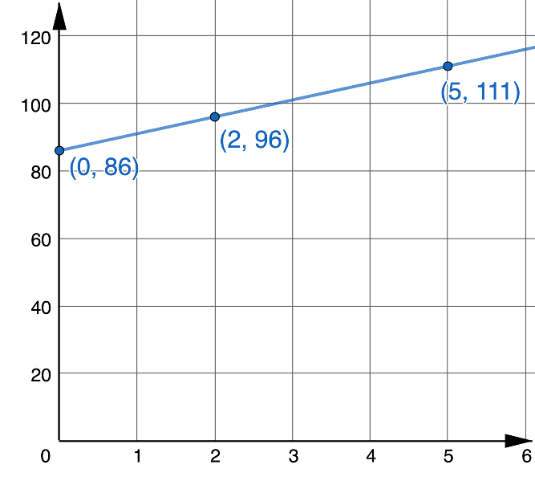
Tourism is a major industry for Florida. The graph shows the total number of visitors, in millions, who traveled to Florida from 2011 to 2017.
Write a linear equation in slope-intercept form that represents this relationship.
volume 1, pg. 330

Slide 21

Wrap-Up
volume 1, pg. 330

Slide 22
7.9.5 Wrap-Up: Reflection
In this unit, you have learned multiple concepts about linear relationships, including those listed below.
Finding the slope of a linear relationship
Finding the 𝑦-intercept of a linear relationship
Interpreting the slope and 𝑦-intercept in context
Graphing a linear relationship
Writing the equation of a linear relationship
volume 1, pg. 330

Slide 23

Use the stoplight reflection below to share how you are feeling about each of these concepts at this point.
 | I still feel stuck on how to …
 | I’m starting to get the hang of …
 | I feel confident and ready to go with …
volume 1, pg. 330

